Slide 1
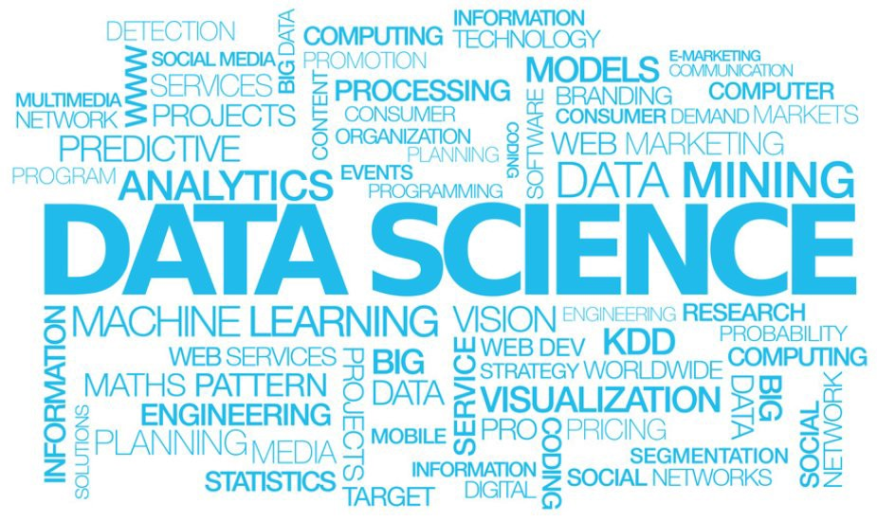
Data Science Capstone Project
Yupeng Yang
Data Science, The George Washington University
December 03, 2018

Slide 2
Motivation:
As a graduate student in our Data Science Program, I have been making significant progress since I came here. Based on my skills and knowledge acquired during the previous precious semesters, I decide to develop a synthetic project, including many subprojects and multiple techniques I learned.

Slide 3
About this project：
1. Creating self-designed Personal Webpage and performing an analysis focused on the Box Office Revenue;
2. Obtaining reliable data information from the most popular movie information website by Web Scraping technique (Data Source: https://www.boxofficemojo.com, which is the leading online box-office reporting service, the #1 movie website in the world);
3. Visualizing the data information by building various charts and distribution maps for several countries and companies in different years;
4. Making predictions and conclusions based on Time Series Analysis (such as using ARIMA Model), giving scientific suggestions and recommendations to film makers and customers.
Programming Languages: Python, HTML, CSS, JavaScript

Slide 4

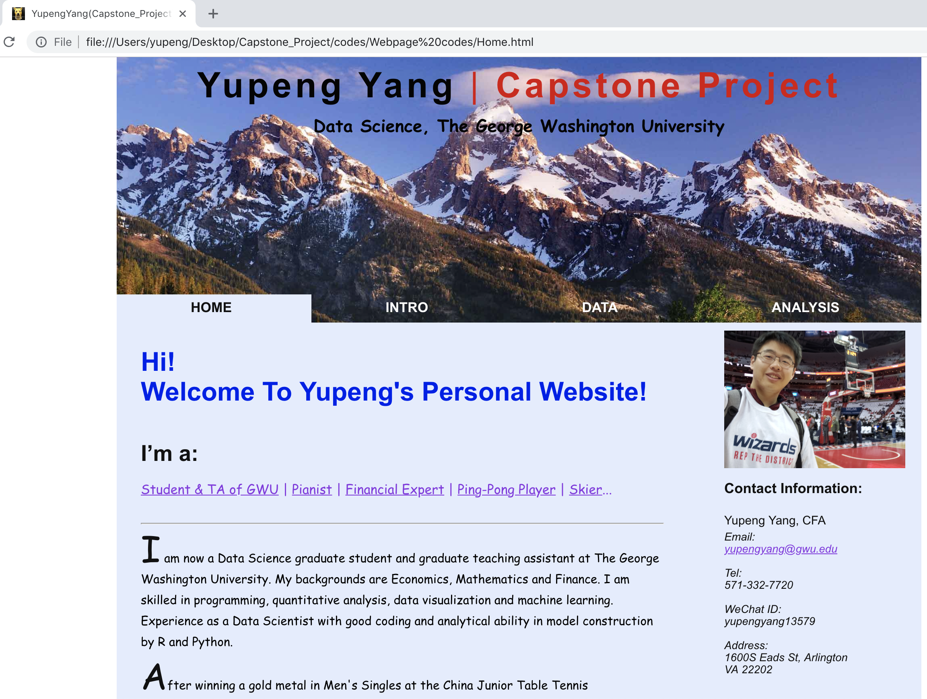
1. Personal Website
This is a web-based project
Let’s take a look at how I designed my webpages
Highlights:
Title
Menu Bar
Main Content
Side Bar

Slide 5
1. Personal Website
Will use the webpages to present in class from here.

Slide 6
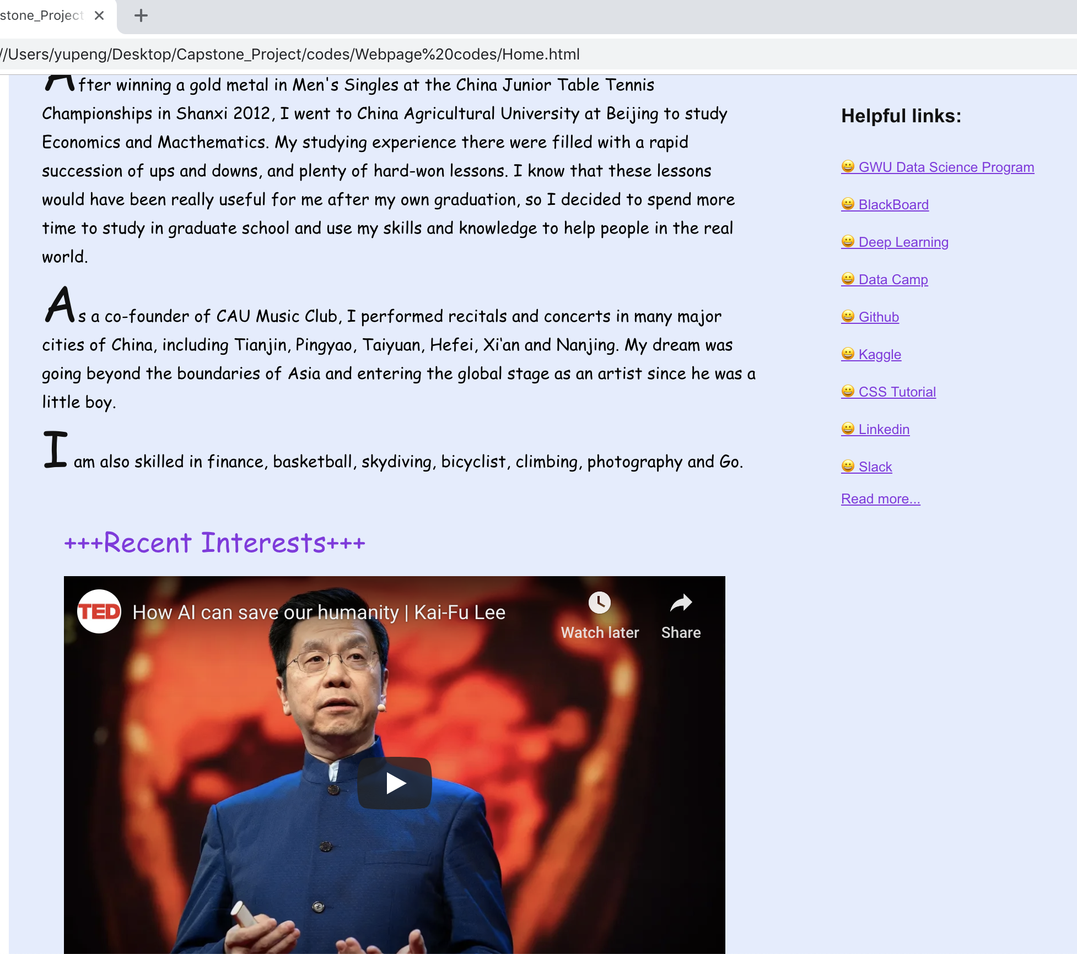
1. Personal Website
Links
Videos

Slide 7
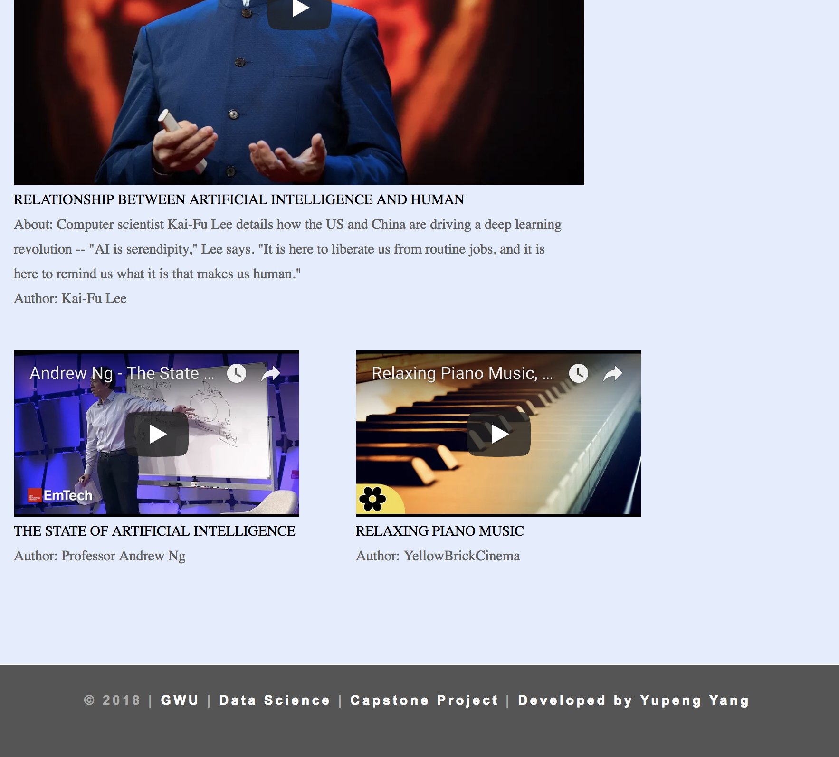
1. Personal Website
Footer

Slide 8
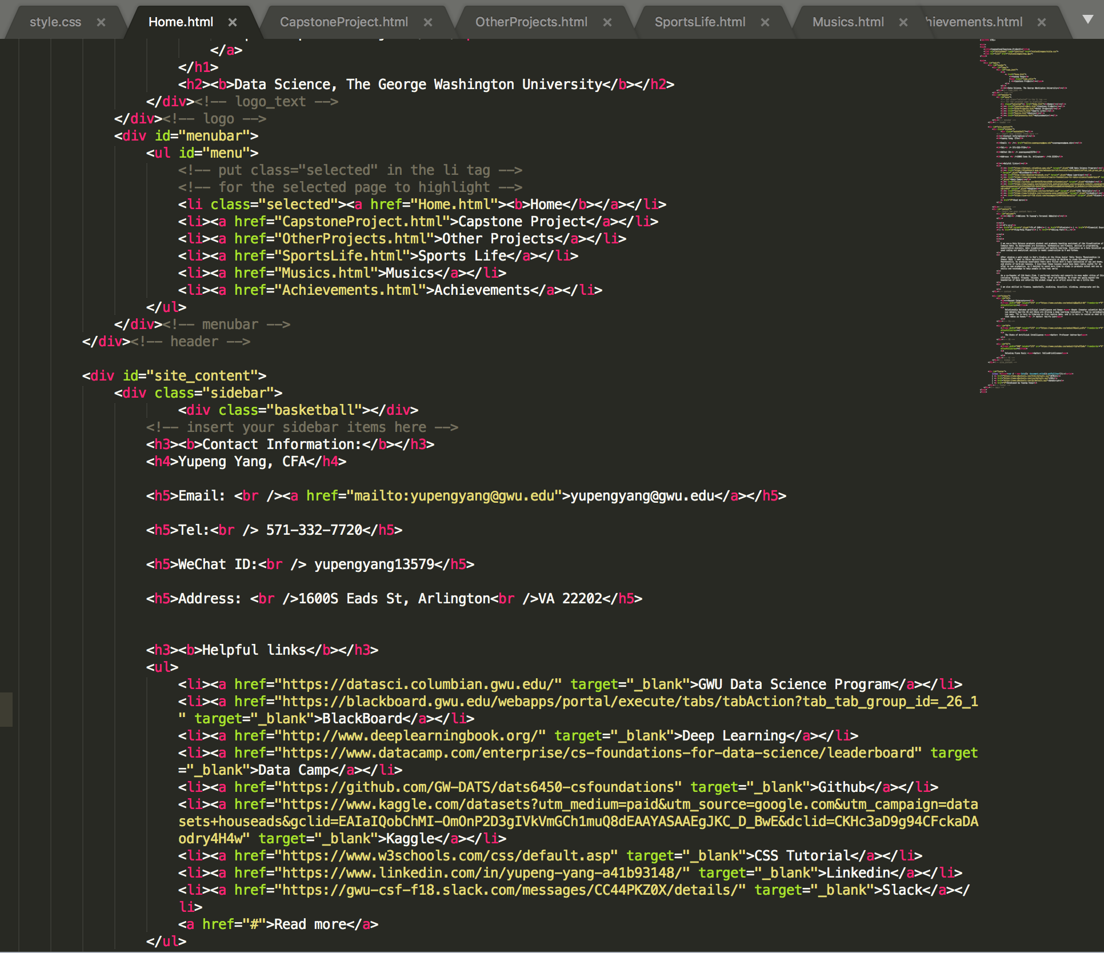
1. Personal Website
My HTML Codes to build my Personal Website

Slide 9
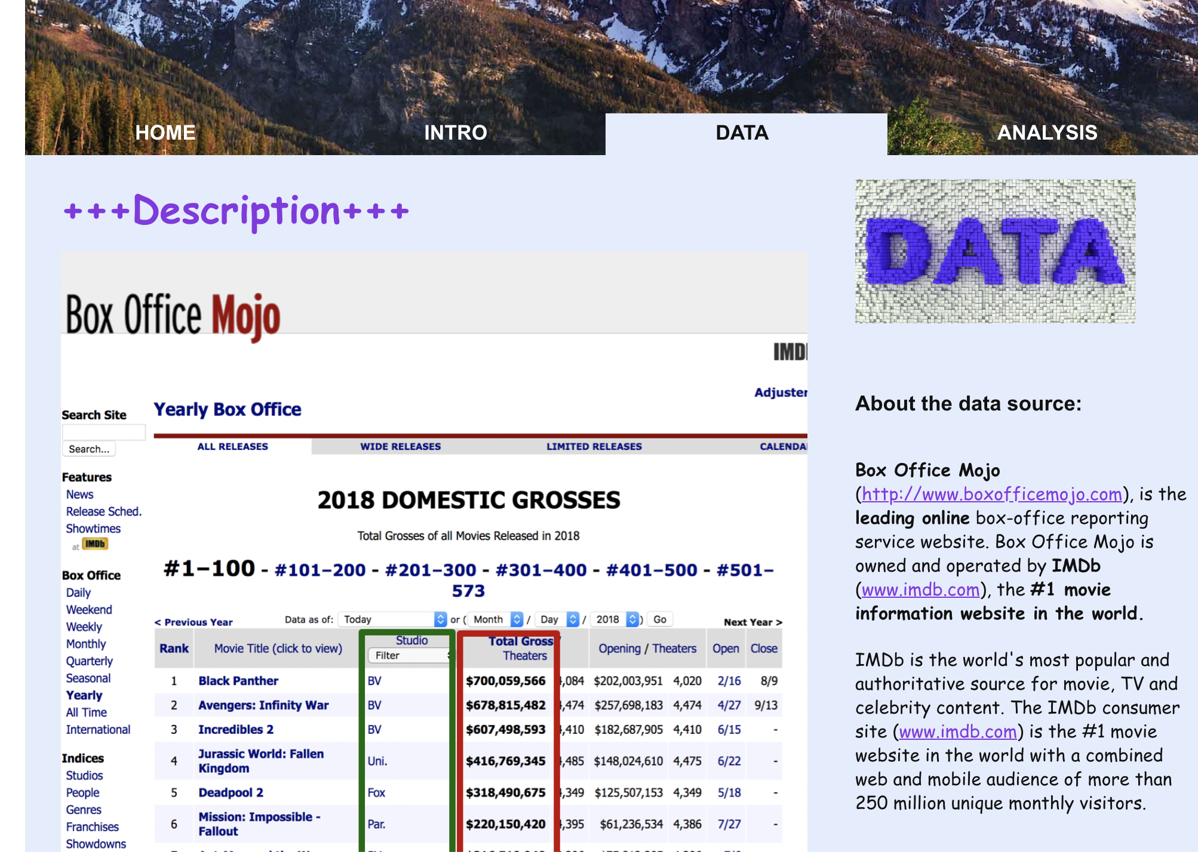
2. Data (web scraping)

Slide 10
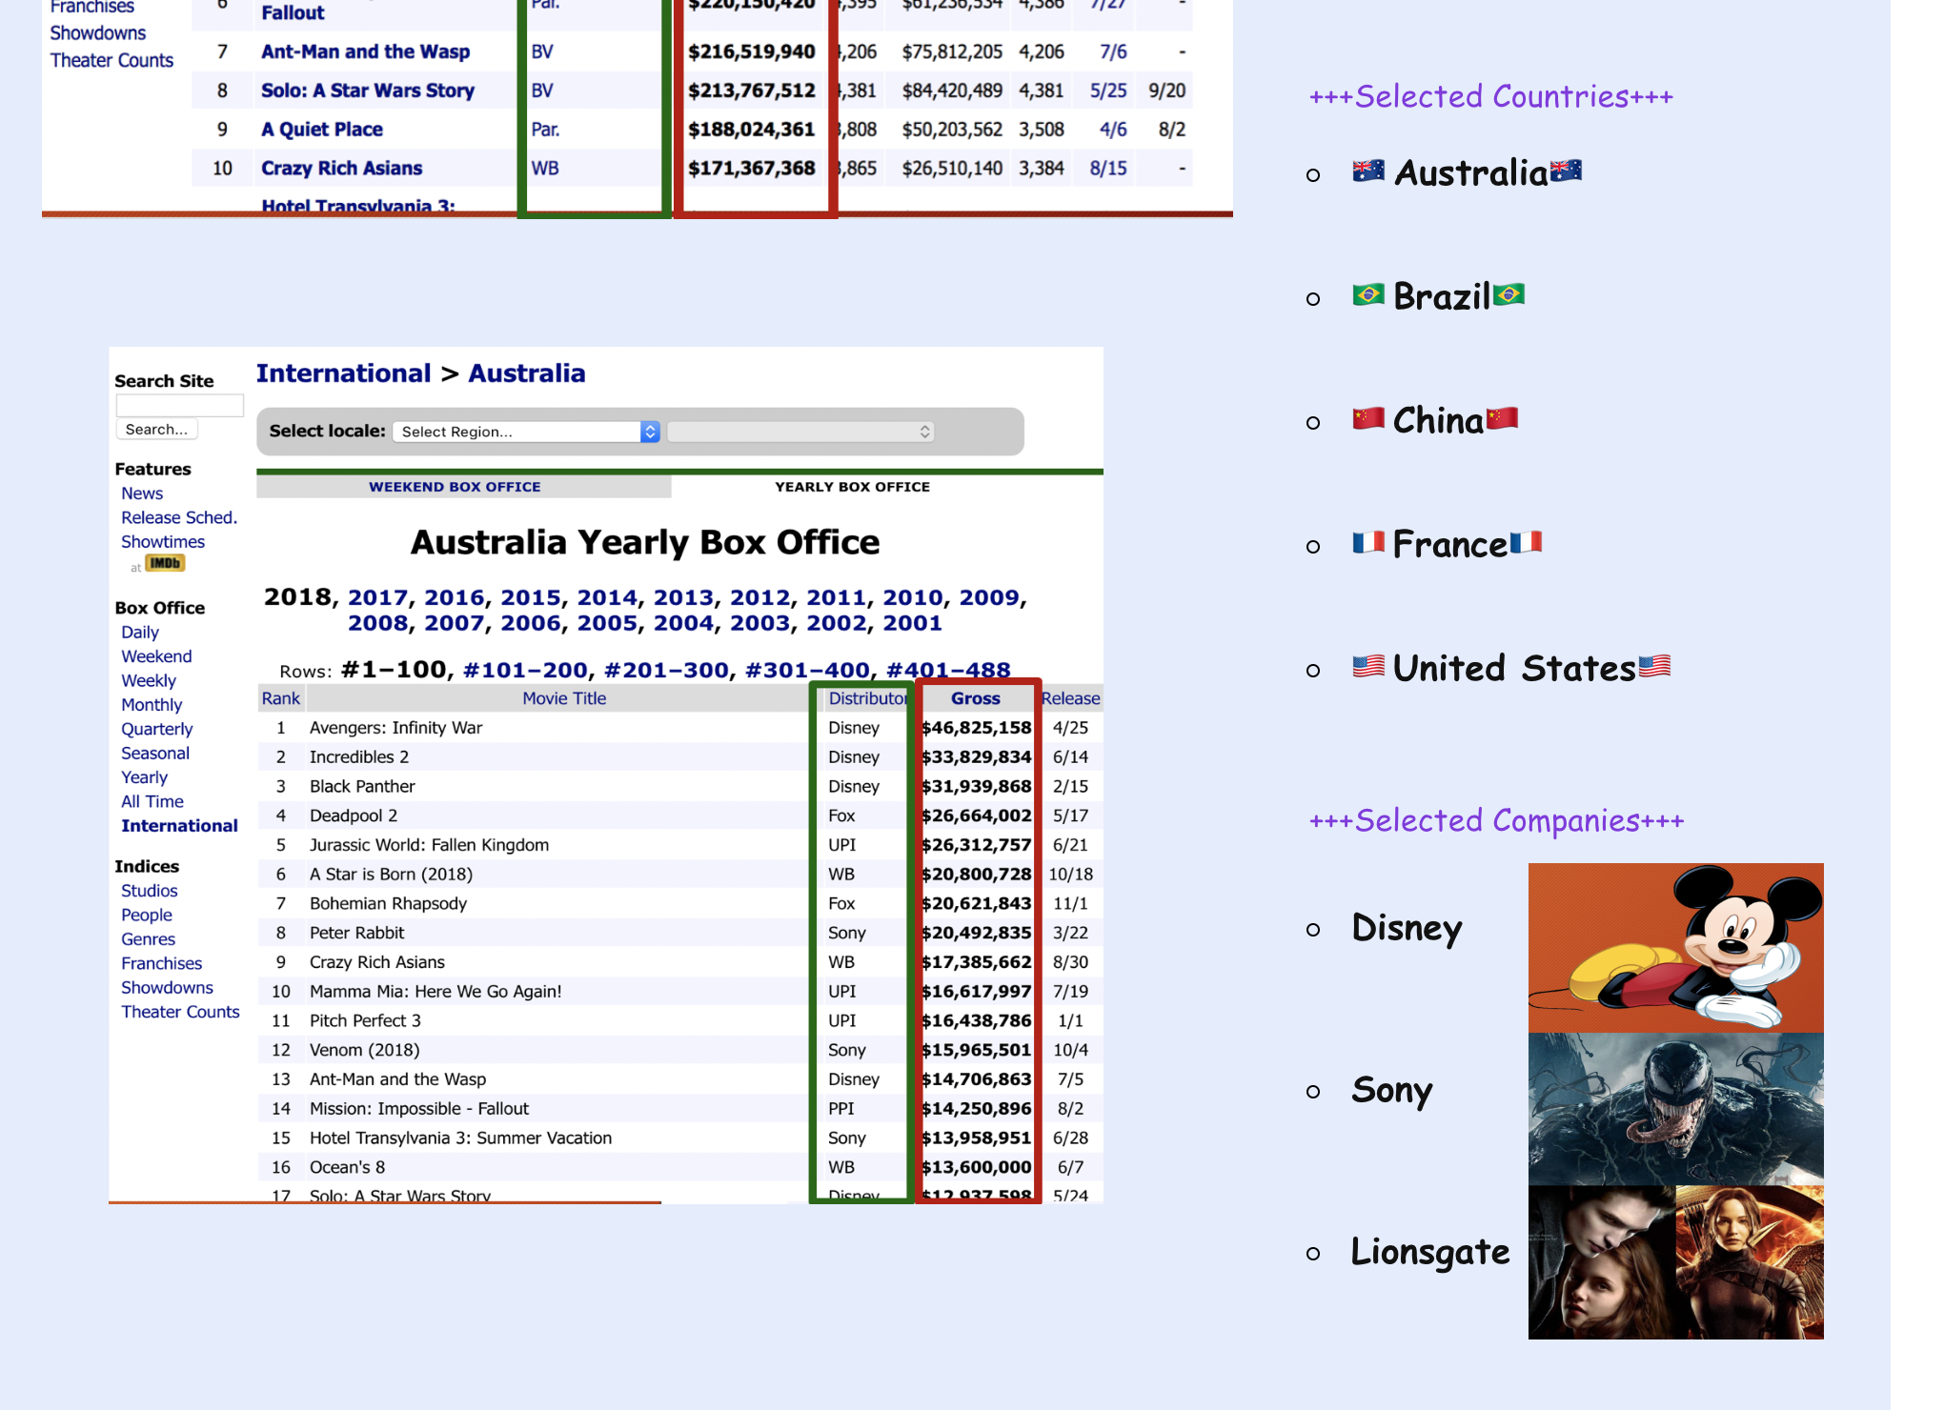
2. Data (web scraping)

Slide 11
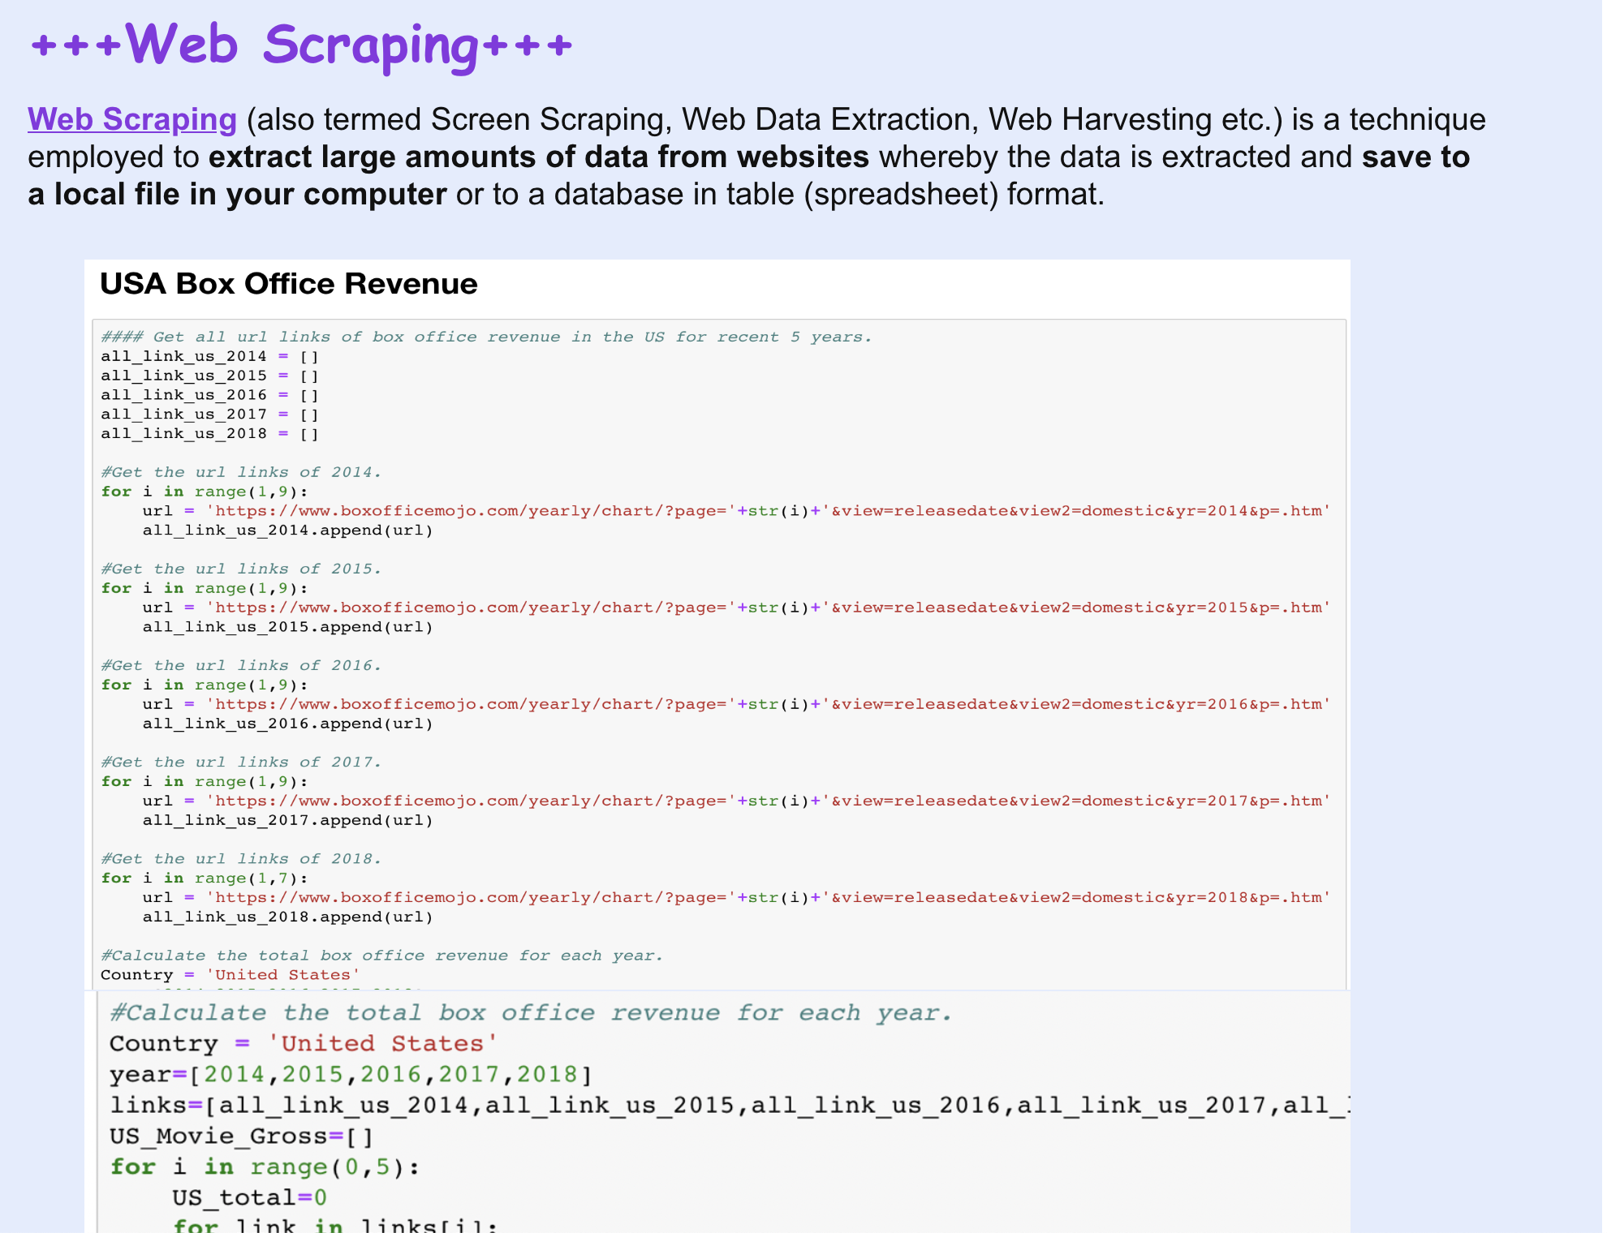
2. Data (web scraping)

Slide 12
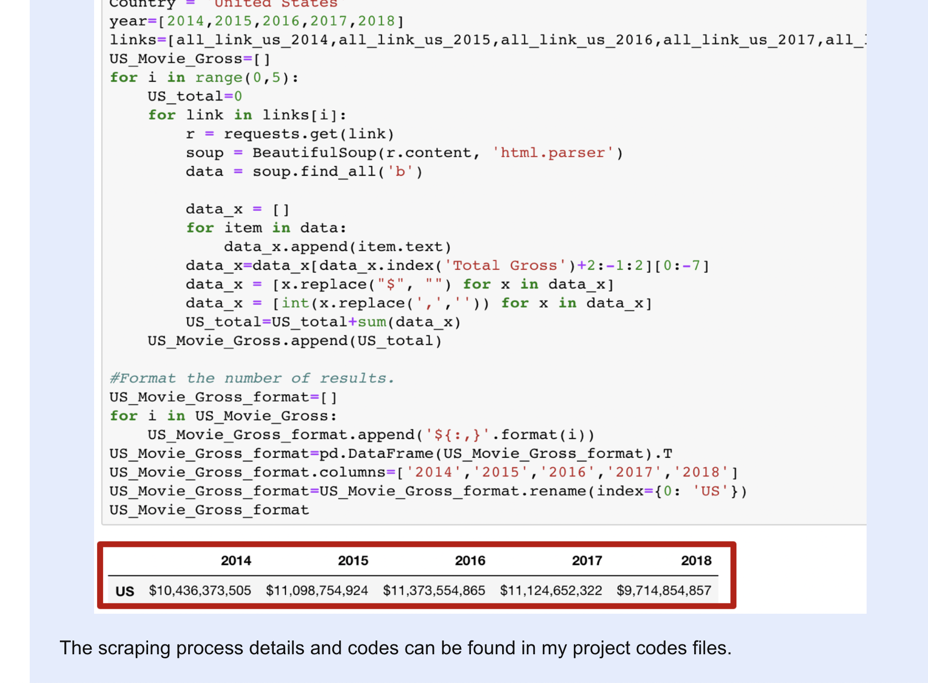
2. Data (web scraping)

Slide 13
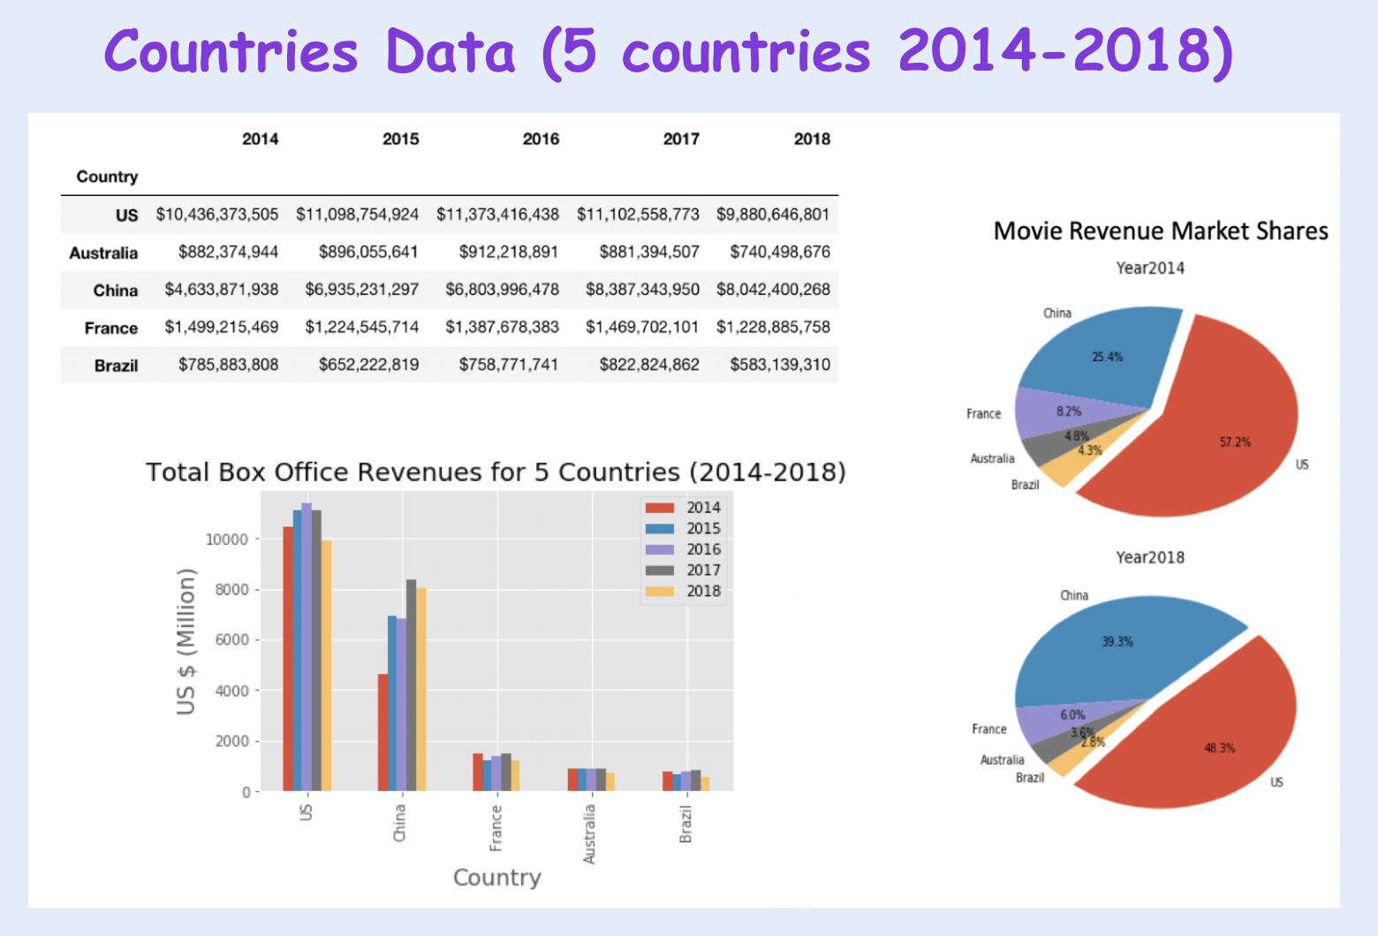
2. Data (Visualization)

Slide 14
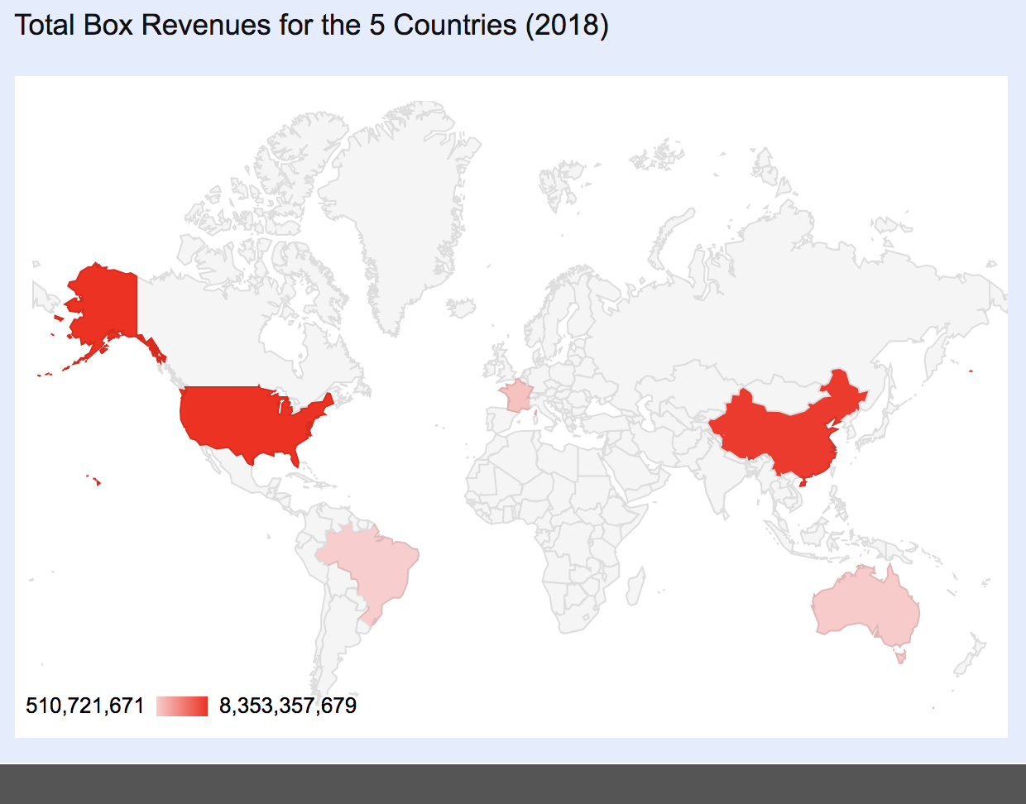
2. Data (Visualization)
Google API:
A set of application programming interfaces (APIs) developed by Google which allow communication with Google Services and their integration to other services.
Google Loader:
JavaScript library which allows web developers to easily load other JavaScript APIs provided by Google and other developers of popular libraries.

Slide 15
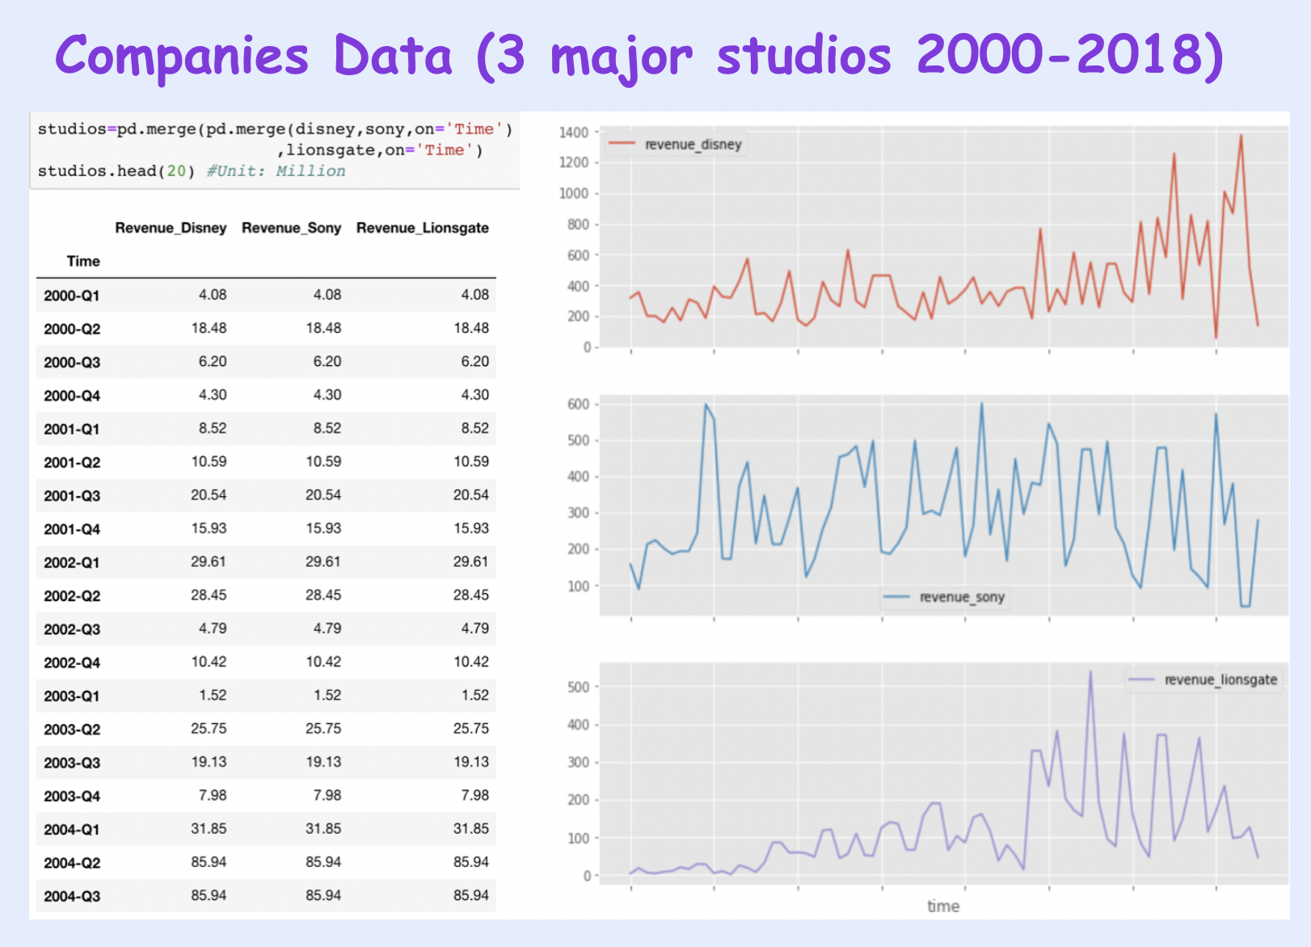
2. Data (Visualization)

Slide 16
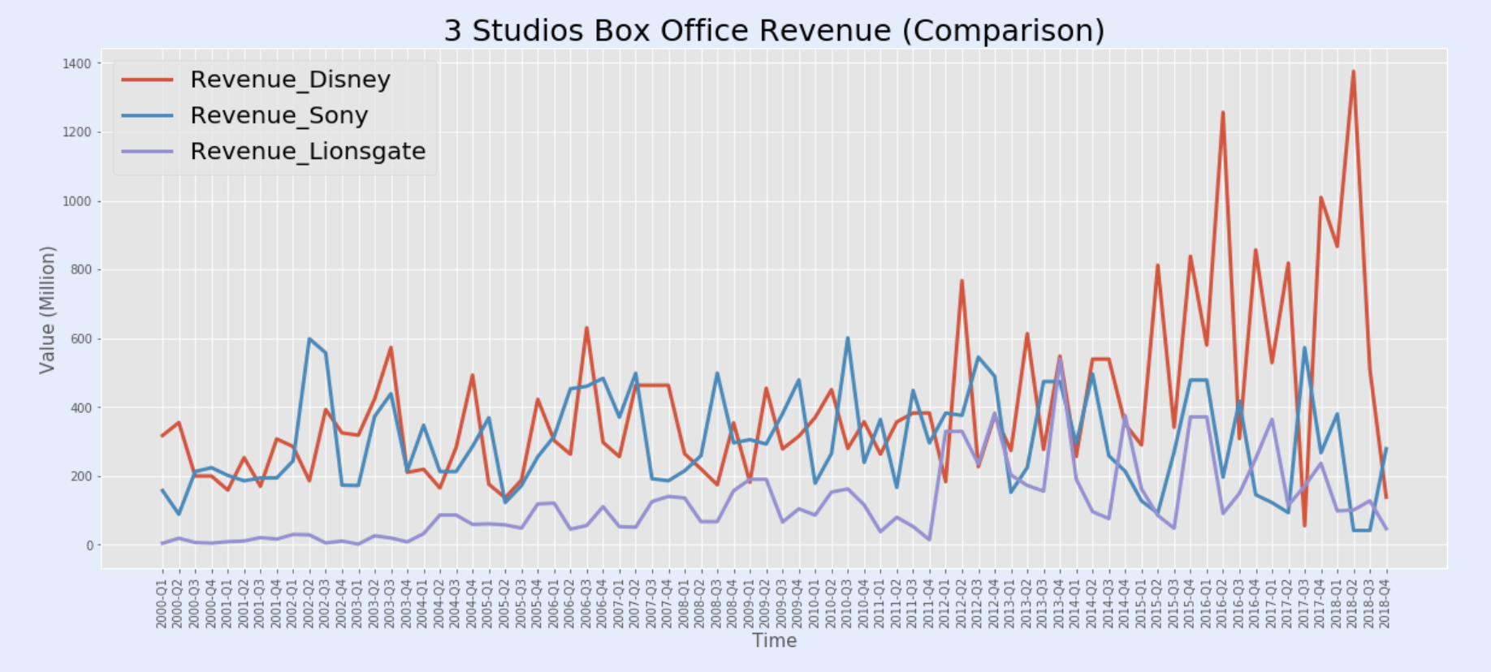
2. Data (Visualization)

Slide 17
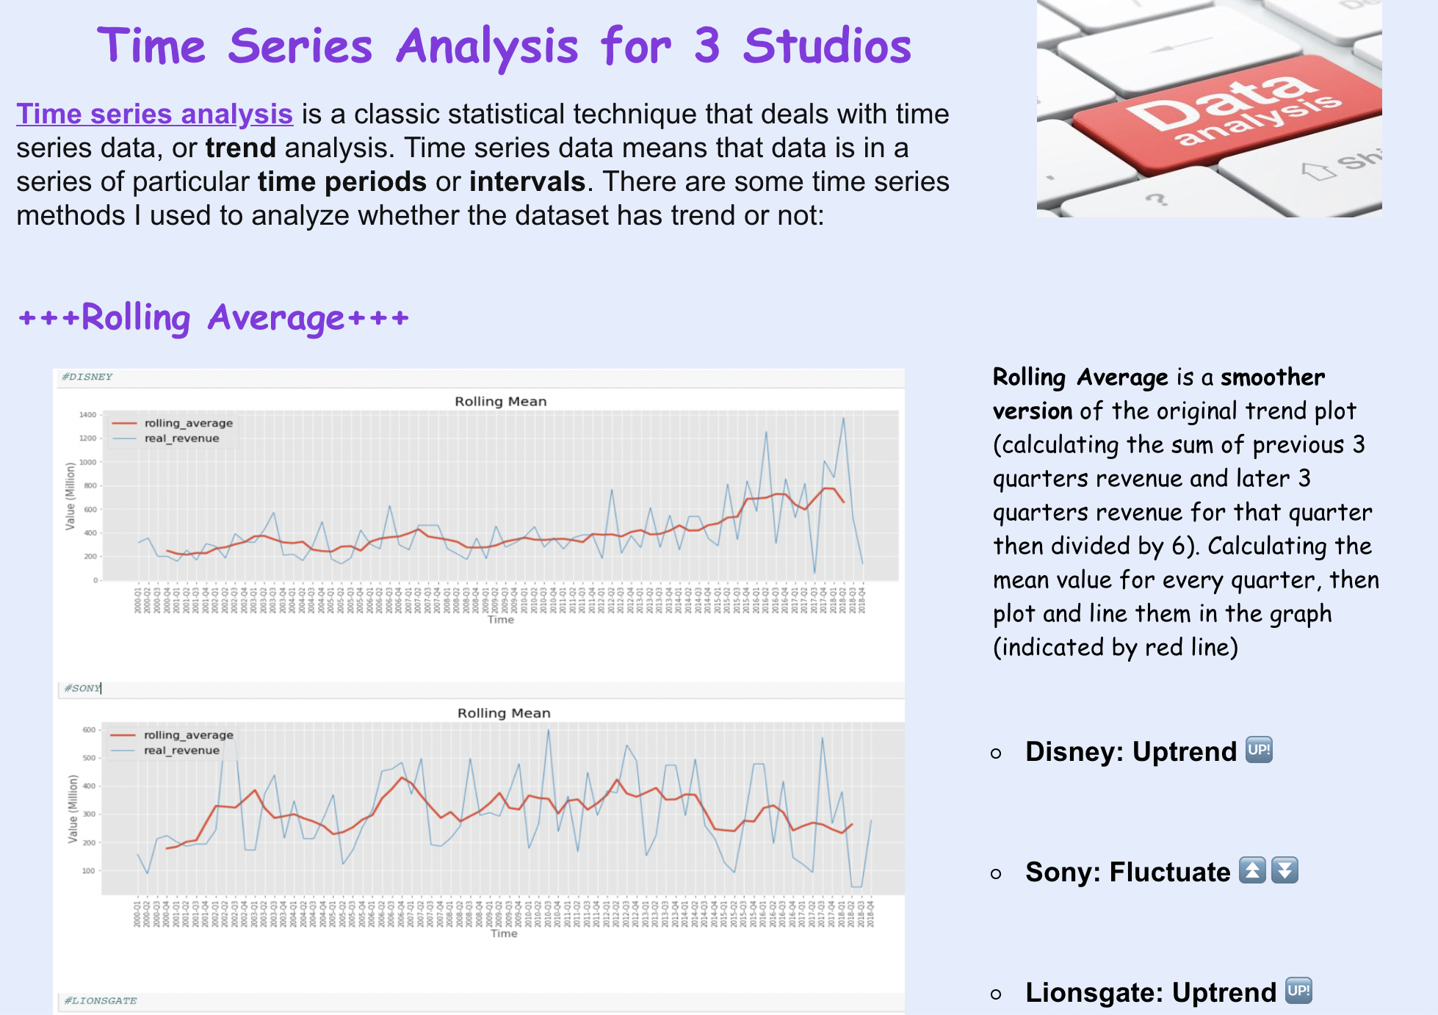
3. Time series analysis

Slide 18
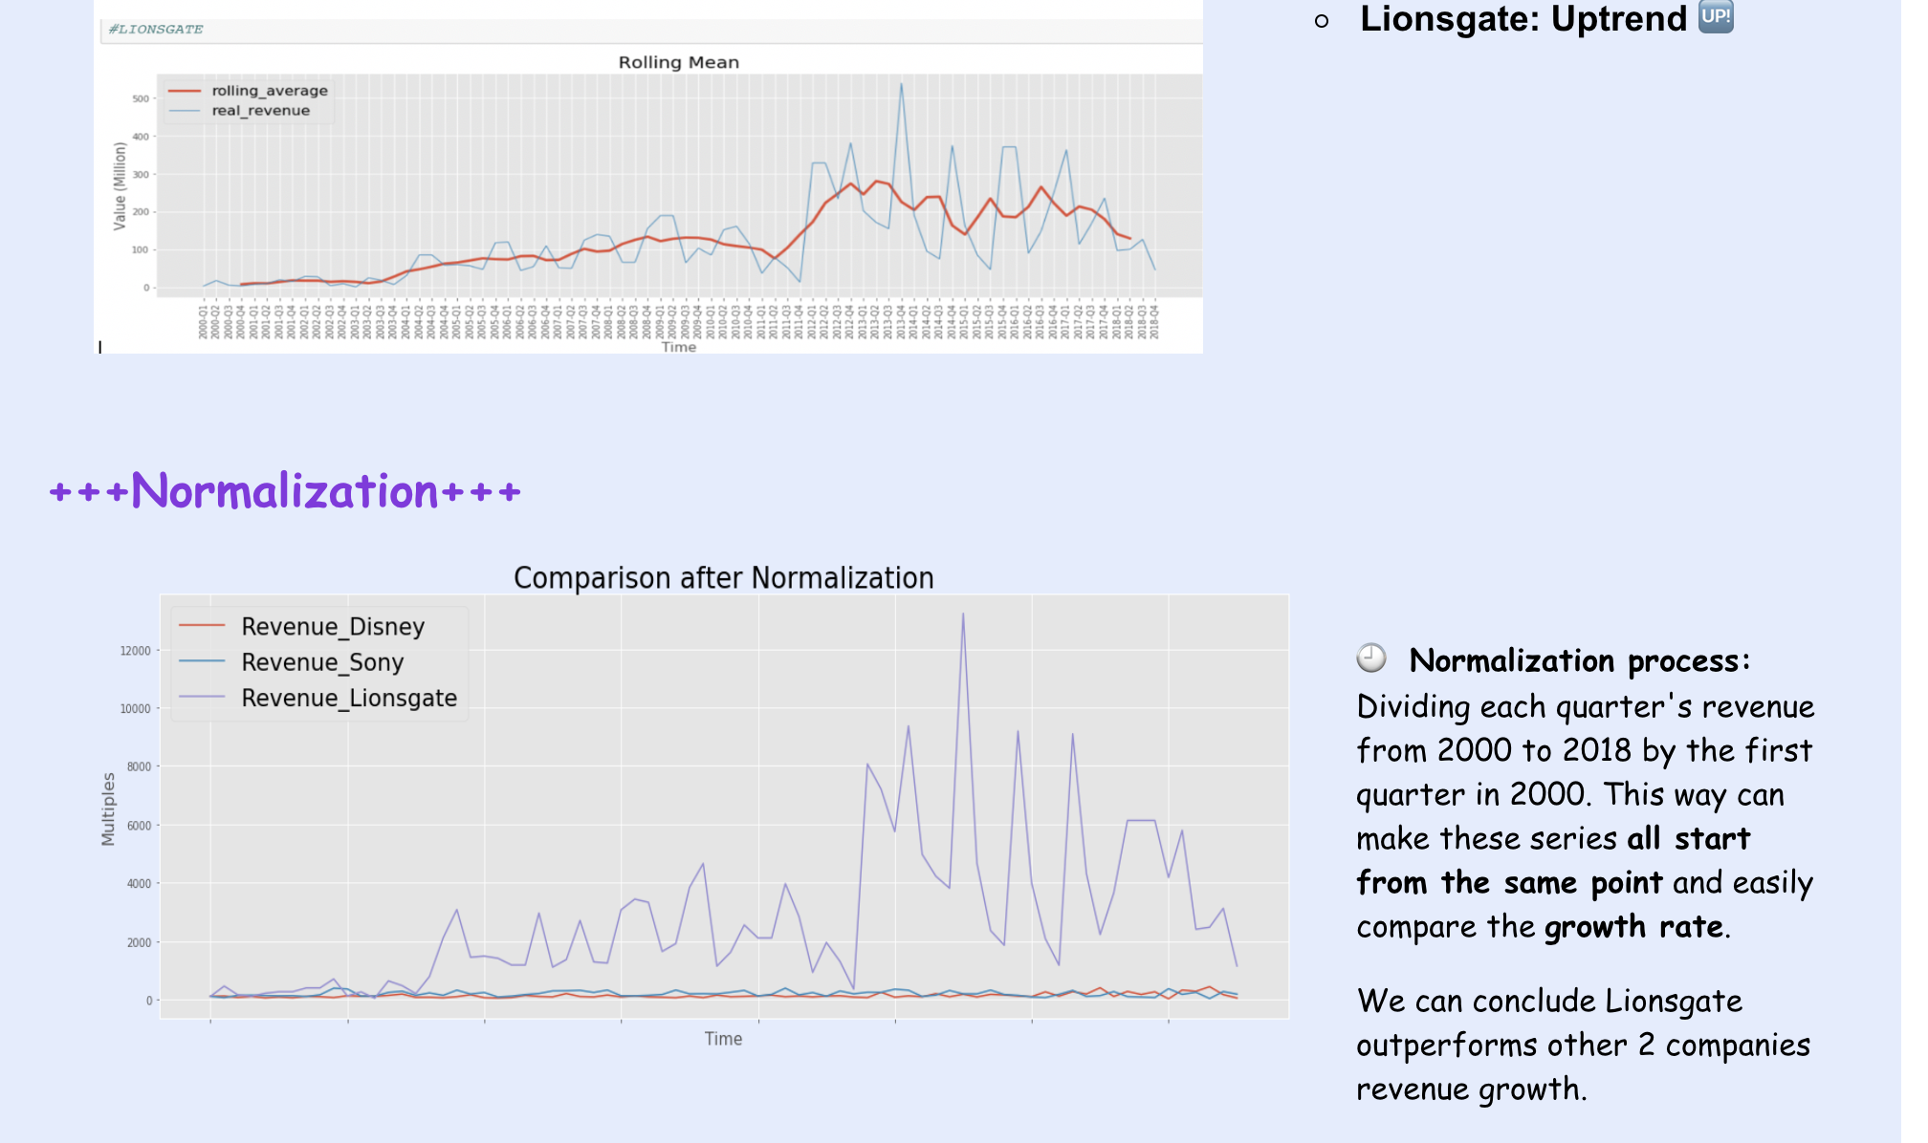
3. Time series analysis

Slide 19
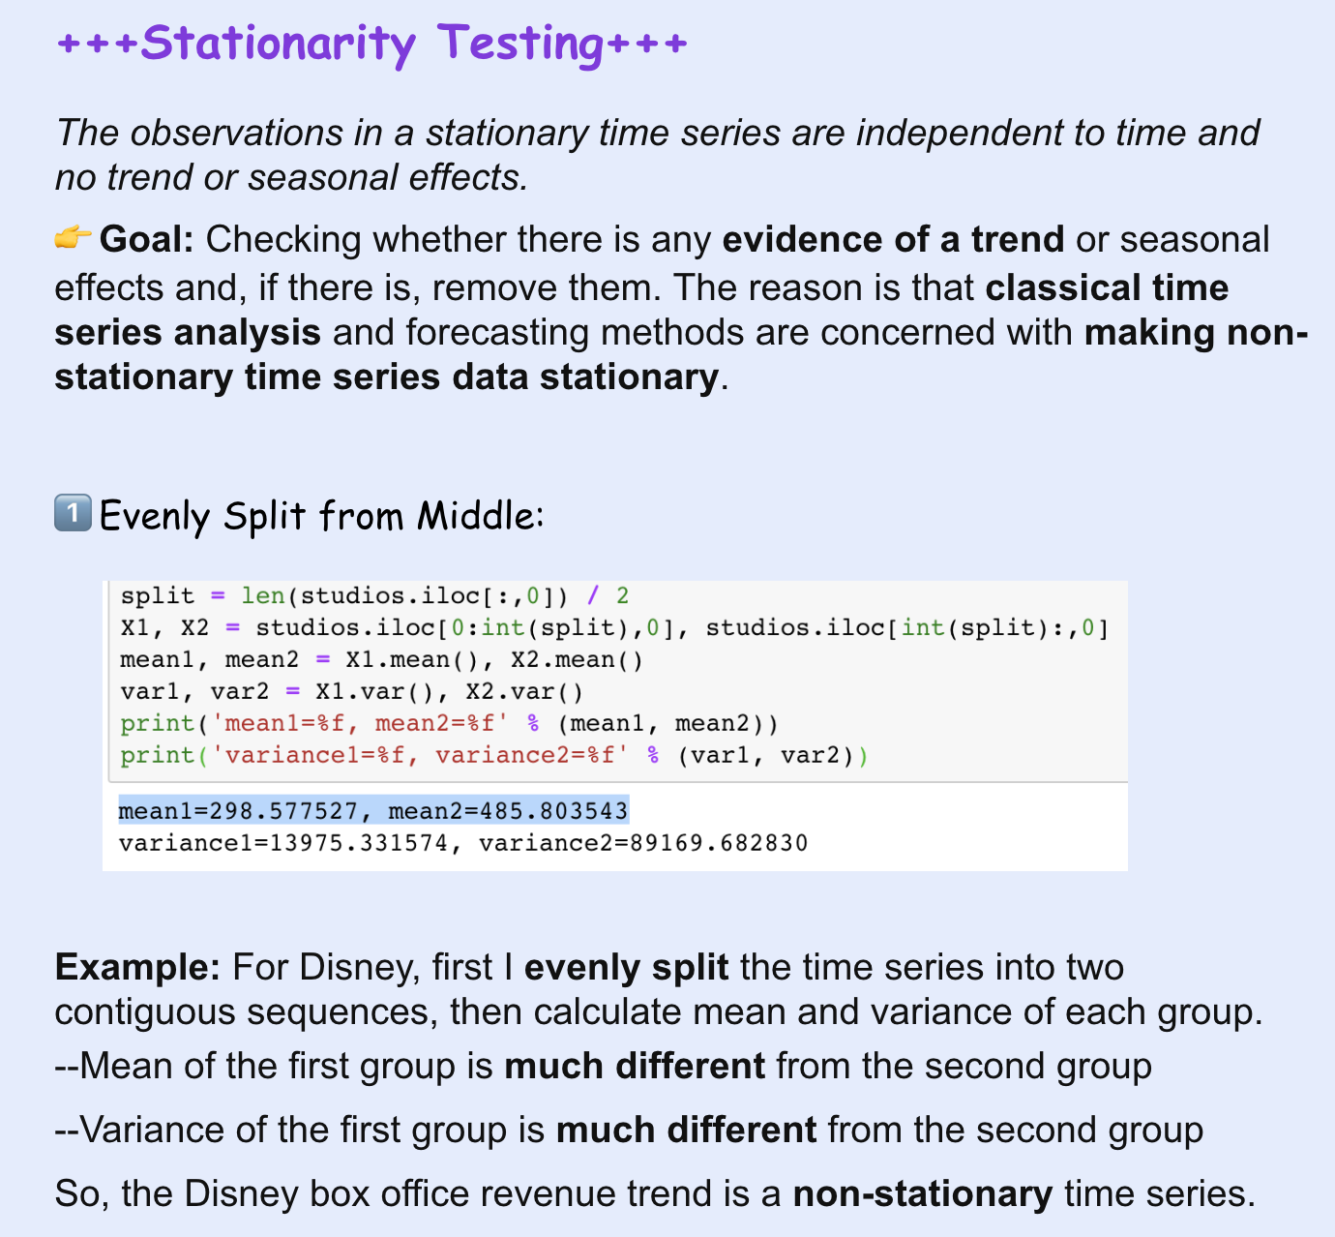
3. Time series analysis

Slide 20
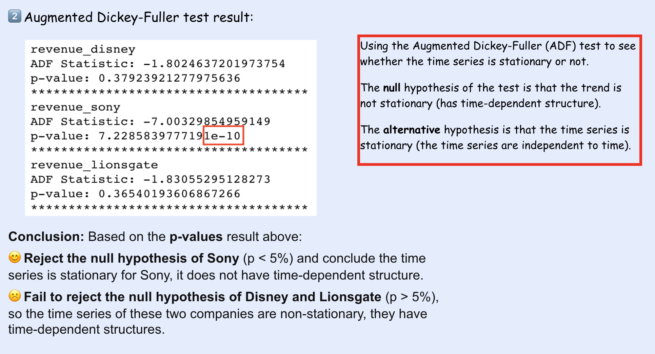
3. Time series analysis

Slide 21
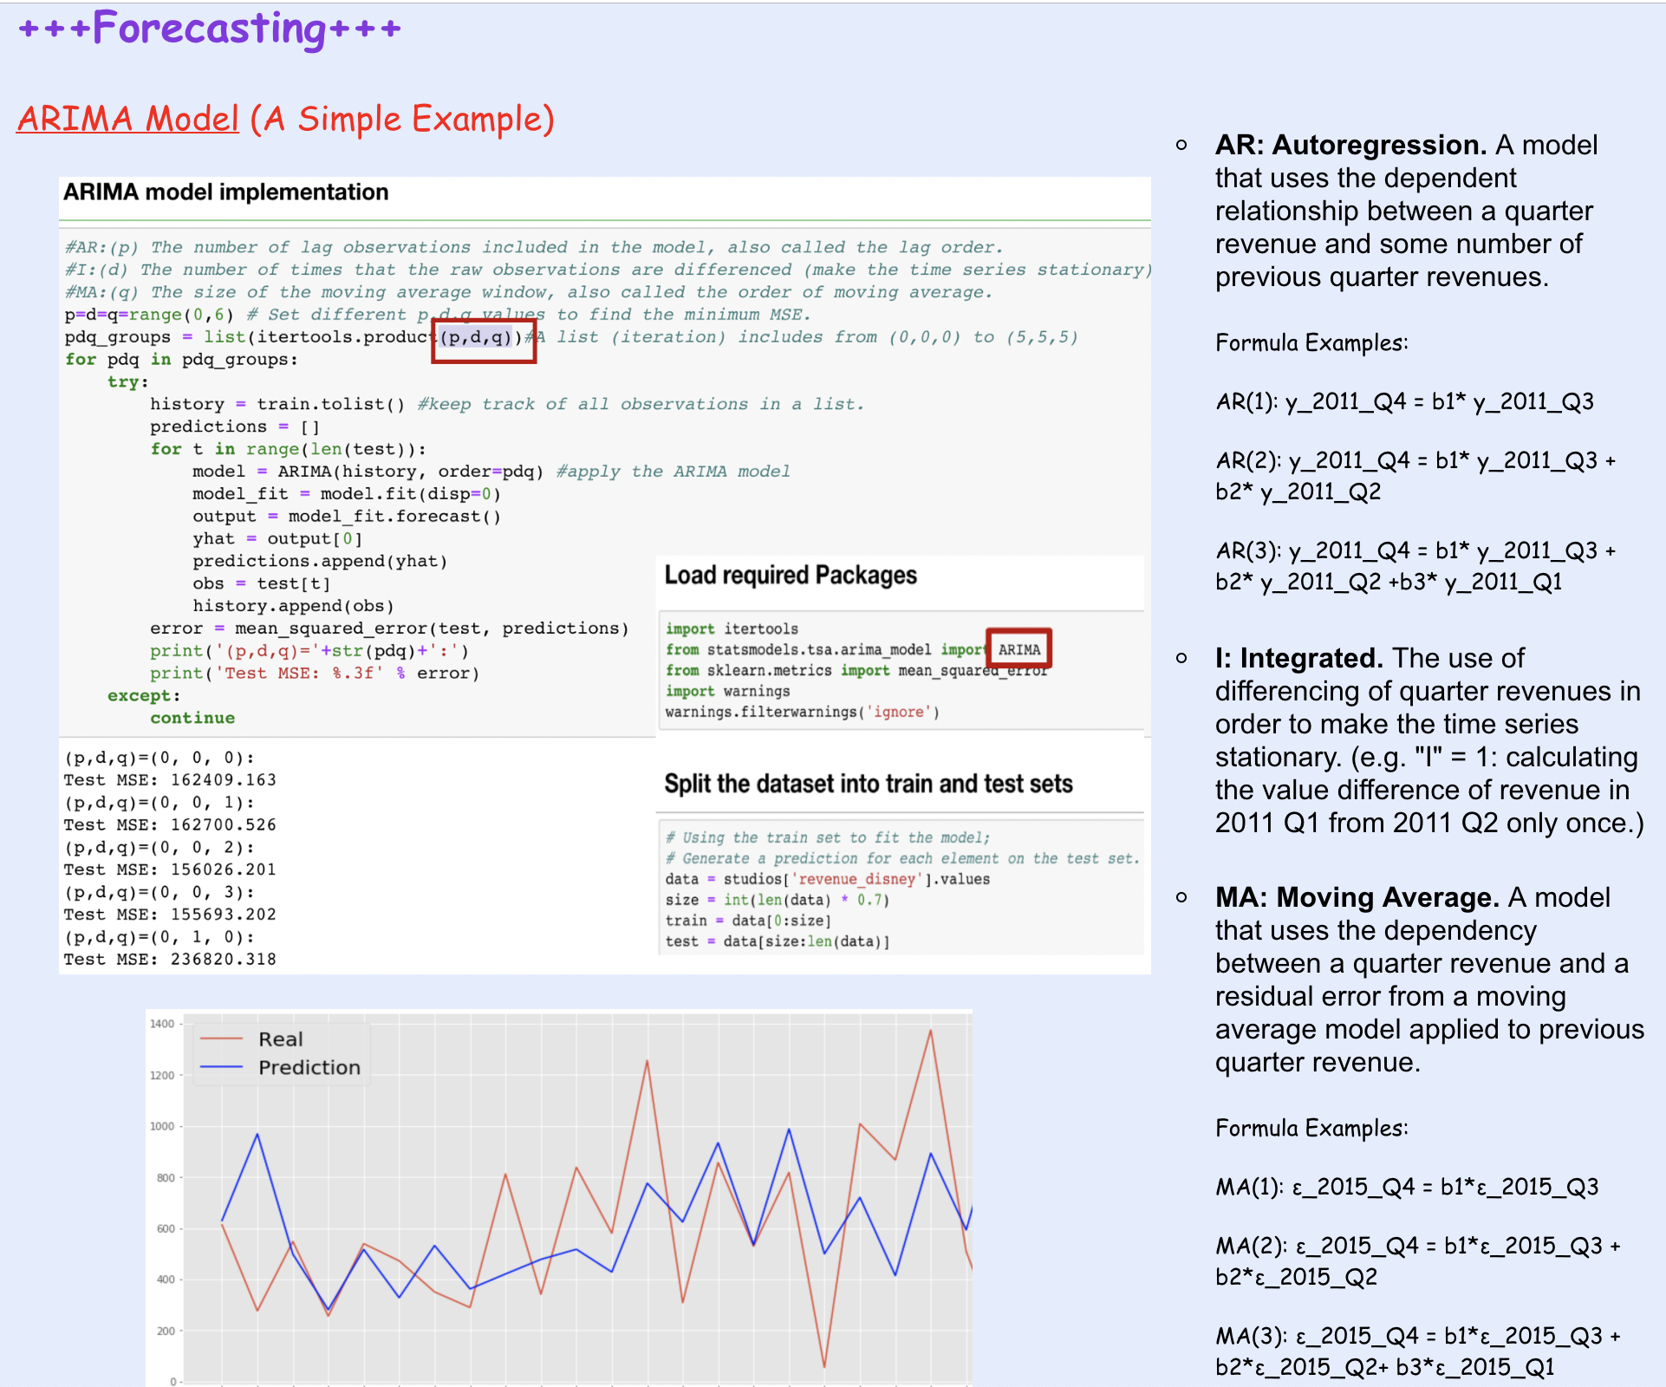
3. Time series analysis

Slide 22
Thank you!

Slide 23
Useful Reference Links:
https://business.tutsplus.com/articles/best-personal-domain-name-extension--cms-28169
https://www.mulesoft.com/resources/api/what-is-an-api
https://developers.google.com/maps/documentation/geocoding/get-api-key
https://www.jstor.org/stable/2958008?seq=1#page_scan_tab_contents
https://bl.ocks.org/mbostock/1256572
https://plot.ly/python/choropleth-maps/
http://www.sciedu.ca/journal/index.php/air/article/view/1390
https://medium.freecodecamp.org/how-to-scrape-websites-with-python-and-beautifulsoup-5946935d93fe
https://www.youtube.com/watch?v=bhjg0TZssI8
https://www.youtube.com/watch?v=_u_jm1211D4

